Slide 1
Hybrid AI Framework for
Loan Eligibility Prediction
&
Document Verification

Slide 2
Abstract
AI-driven credit assessment systems are increasingly adopted in the banking sector to improve the speed and accuracy of loan decision-making. Recent approaches, such as LLM-based multi-agent frameworks suffer from high computational costs, limited scalability, and the absence of explicit document verification mechanisms.
This project presents a hybrid AI-based system that combines a small language model for loan eligibility prediction with a LlamaIndex-powered document verification module. It delivers transparent decisions—Eligible, Not Eligible, or Flagged for Review—while enhancing scalability, explainability, and fraud detection.

Slide 3
Scope of the Project
System Design
Development of a hybrid AI framework for loan eligibility and document verification
Eligibility Prediction
Loan eligibility assessment using a fine-tuned small language model on applicant data
Document Verification
Automated extraction and validation of information from salary slips, ID proofs, and bank statements using LlamaIndex
Decision Integration
Fusion of eligibility prediction and document verification results into a unified decision layer
Operational Impact
Reduction of manual verification effort with support for human-in-the-loop decision-making

Slide 4
Existing Systems
Machine Learning Based Loan Eligibility Prediction
Machine Learning (ML) techniques are widely used to automate loan eligibility prediction by learning patterns from historical loan data. These models operate on structured data.
Models: Logistic Regression, Random forest, Decision Trees, SVM.
LLM-Based Multi-Agent Credit Assessment Systems
Large Language Models (LLMs) use transformer architectures with self-attention mechanisms to perform reasoning-based credit analysis.
Models: GPT –based LLMs

Slide 5
Challenges of Existing Systems
Machine Learning–Based Loan Eligibility Prediction
LLM-Based Multi-Agent Credit Assessment Systems
Limited Feature Representation
Dependence on Structured Data
Manual Feature Engineering
Scalability & Generalization Issues
High Computational Cost
Limited Explainability
Latency in Real-Time Processing
Integration Complexity

Slide 6
Proposed System: The Hybrid AI Framework
Core Innovation
A dual-track system balancing specialized classification with generative document
intelligence.
Predictive Track (SML)
Fine-tuned model optimized for customer profile data like income, credit score,
and employment history and loan eligibility knowledge.
Verification Track (LlamaIndex)
Generative AI module for validating salary slips, ID proofs, and bank statements
against application claims.
Fusion Layer
Combines the Predictive Track and Verification Track results
Provide the final decision as Eligible, Not Eligible, or Flagged for Review

Slide 7
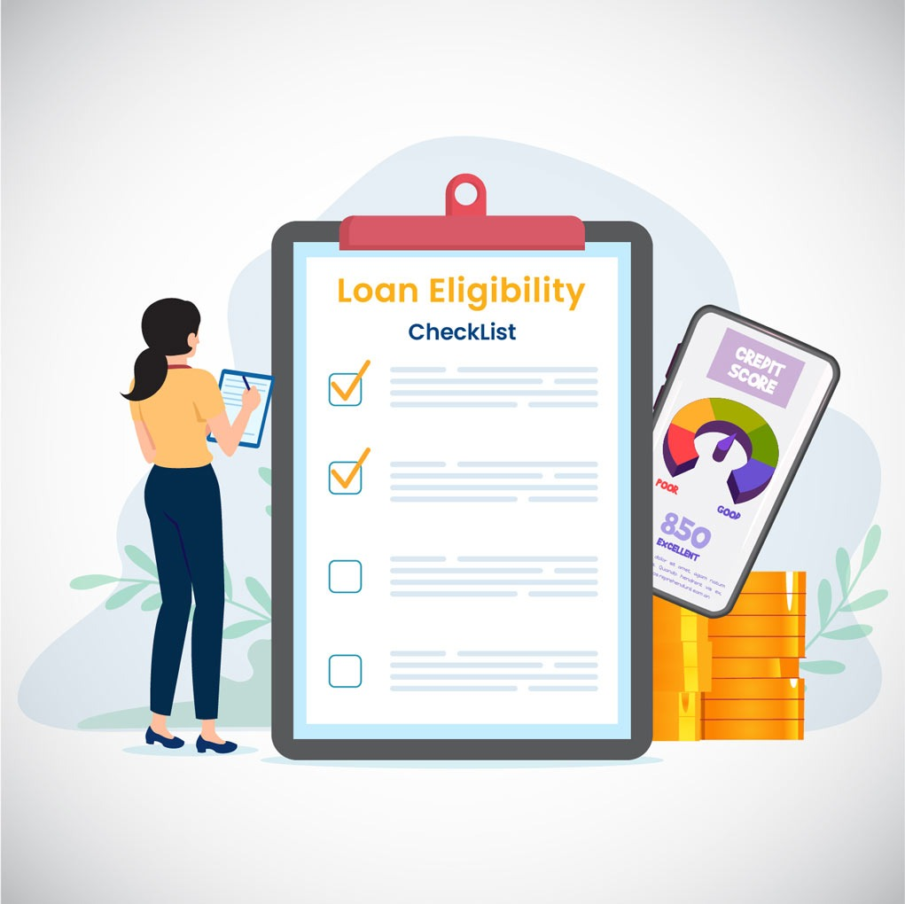
Phase 3: Document Verification
Accepts applicant documents
Uses LlamaIndex to parse documents efficiently
Extracts key entities like income, employer name, and account balance
Cross-checks extracted information with user declared data
Phase 4: Fusion & Decision Layer
Combines SML eligibility results and document verification results
Applies rule-based decision logic
Produces final classification

Slide 8
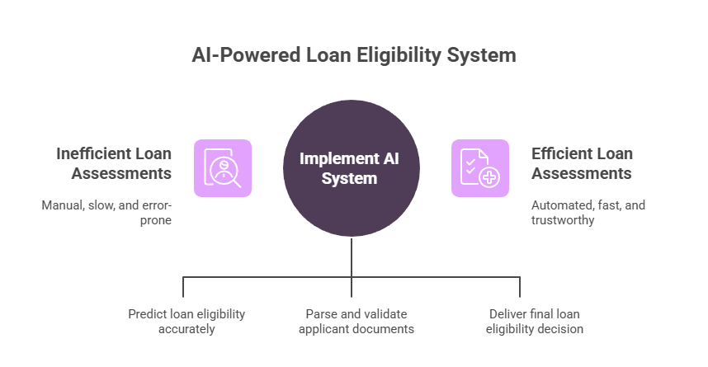
Existing System
Proposed System

Slide 9
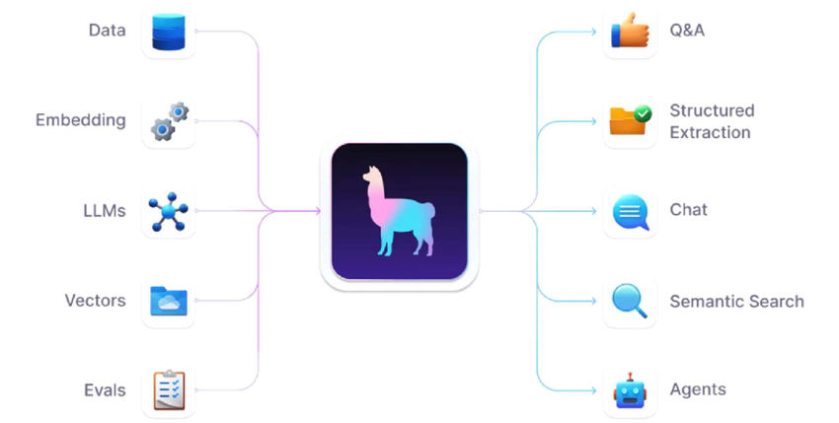
References & Literature
Devlin, J., et al. (2018)
BERT: Pre-training of Deep Bidirectional
Transformers for Language Understanding.
Liu, J., et al. (2023)
LlamaIndex: Data Framework for LLM Applications.
Banking Industry Standards
Guidelines for Document Verification and Credit
Scoring in Automated Systems.
Multi-Agent Systems Research
Comparative Analysis of LLM-based Agents for
Financial Risk Assessment.

Slide 10
THANK YOU

